Slide 1
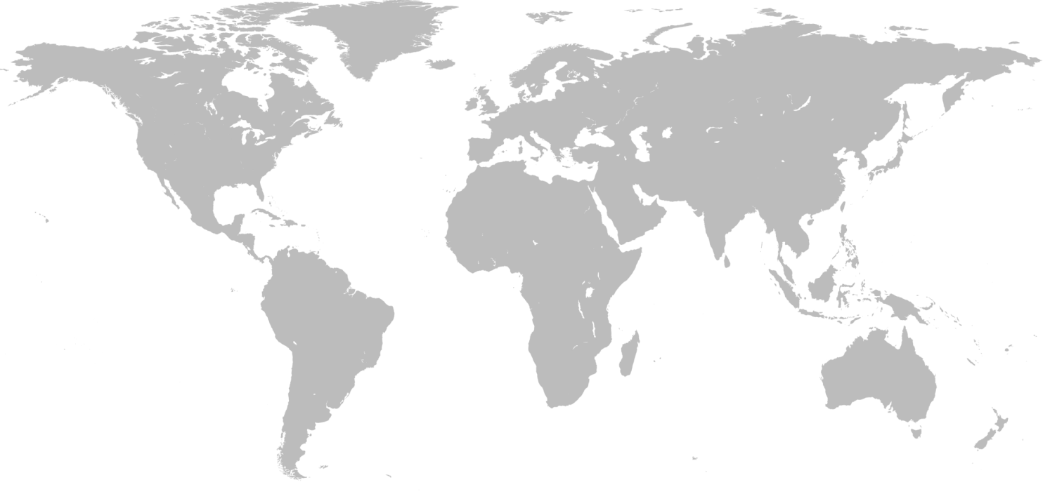
Footprint
PRODUCT LINE HVAC
FT LEIPZIG
Location: Schkeuditz (DE)
Type of site: Global Center of Competences Engineering, Manufacturing
Vapor Rail
Location: Plattsburgh
Type of site: Manufacturing, (Engineering)
FT PLZ
Location: Pilsen (CZ)
Type of site: Manufacturing, Engineering
FT NSF
Location: Lille (FR)
Type of site: Front office, Engineering
FMT
Location: Shanghai (CN)
Type of site: Engineering, Manufacturing
FT SCHWEIZ
Location: Hägendorf (CH)
Type of site: Engineering, small Manufacturing
FT INDIA/Witec
Location: Hosur (IN)
Type of site: Engineering, Manufacturing

